Slide 1
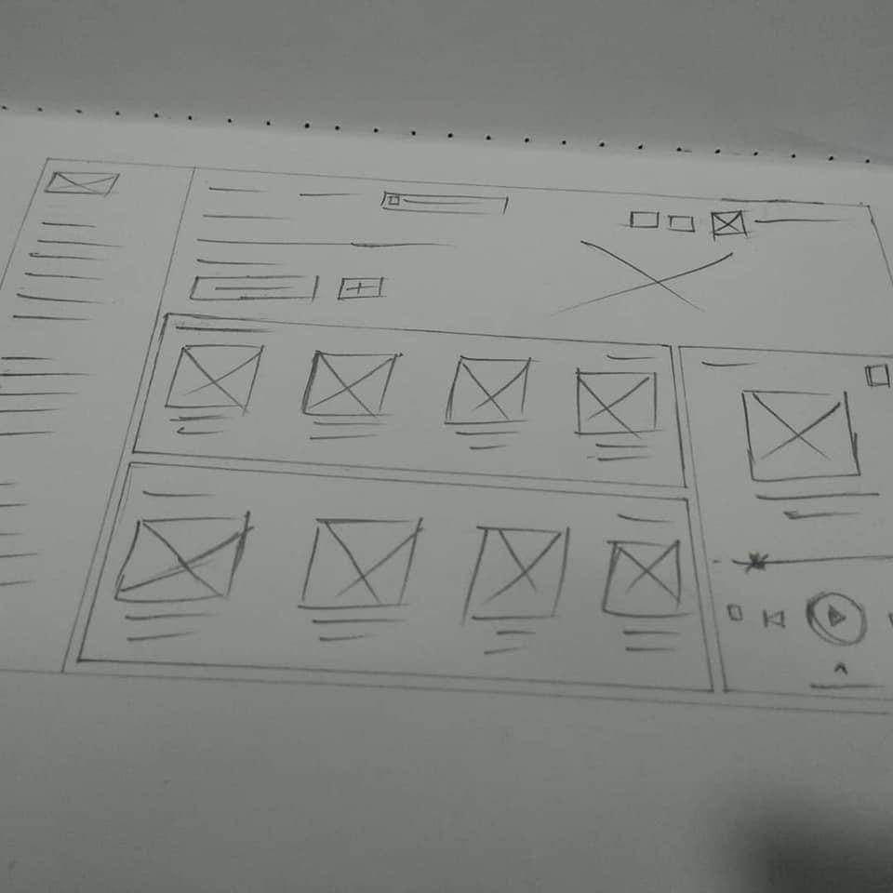
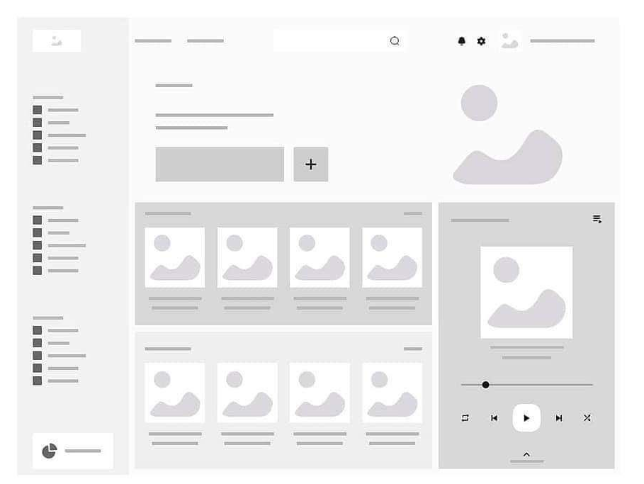

EXPLANATION
WORKFLOW OF DESIGNING WEBSITE
Draw in paper
Draw in Figma
Start coding
1
2
3

Slide 2
PRACTICE
Instruction
From requirement:
1 - Read requirement need in website-requirement.docx file
2 - Using Figma to design mock up with differences device screen (Computer, tablet and mobile)
3 - Choose your CSS Grid or Flex
4 - Write your HTML/CSS code following your mockup design
5 - Make sure your static website support on computer, tablet and mobile screen.

